Slide 1


Slide 2
Direct Memory Access (DMA):
  A special control unit may be provided to transfer a block of data directly between an I/O device and the main memory, without continuous intervention by the processor.
Control unit which performs these transfers is a part of the I/O device’s interface circuit. This control unit is called as a DMA controller.
DMA controller performs functions that would be normally carried out by the processor:
  For each word, it provides the memory address and all the control signals.
  To transfer a block of data, it increments the memory addresses and keeps track of the number of transfers.
Notes:
This alternative approach is called as direct memory access. DMA consists of a special control unit which is provided to transfer a block of data directly between an I/O device and the main memory without continuous intervention by the processor.
A control unit which performs these transfers without the intervention of the processor is a part of the I/O device’s interface circuit, and this controller is called as the DMA controller.
DMA controller performs functions that would be normally be performed by the processor. The processor will have to provide a memory address and all the control signals. So, the DMA controller will also provide with the memory address where the data is going to be stored along with the necessary control signals. When a block of data needs to be transferred, the DMA controller will also have to increment the memory addresses and keep track of the number of words that have been transferred.

Slide 3
The operation of the DMA controller must be under the control of a program executed by the processor. That is, the processor must initiate the DMA transfer.
To initiate the DMA transfer, the processor informs the DMA controller of:
  Starting address- register is used
  Number of words in the block - register is used
  Direction of transfer (I/O device to the memory, or memory to the I/O device) – R/W flag in status and control register
When completes transferring a block of data – Done bit is set to 1
Once the DMA controller completes the DMA transfer, it informs the processor by raising an interrupt signal – IRQ and IE flags in status and control register
Notes:
Repeat DMA controller.
DMA controller can be used to transfer a block of data from an external device to the processor, without requiring any help from the processor. As a result the processor is free to execute other programs. However, the DMA controller should perform the task of transferring data to or from an I/O device for a program that is being executed by a processor. That is, the DMA controller does not and should not have the capability to determine when a data transfer operation should take place. The processor must initiate DMA transfer of data, when it is indicated or required by the program that is being executed by the processor.
When the processor determines that the program that is being executed requires a DMA transfer, it informs the DMA controller which sits in the interface circuit of the device of three things, namely, the starting address of the memory location, the number of words that needs to be transferred, and the direction of transfer that is, whether the data needs to be transferred from the I/O device to the memory or from the memory to the I/O device.
After initiating the DMA transfer, the processor suspends the program that initiated the transfer, and continues with the execution of some other program. The program whose execution is suspended is said to be in the blocked state.

Slide 4
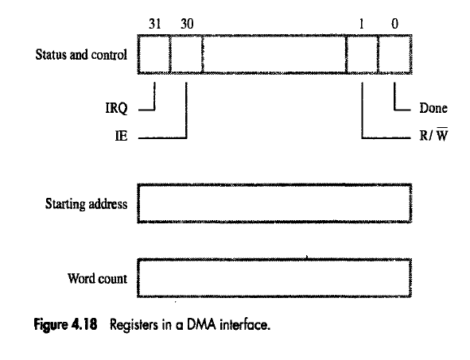

Slide 5
Main
Processor
memory
System bus
Disk/DMA
DMA
Printer
Keyboard
controller
controller
Disk
Disk
Network
Interface
DMA controller connects a high-speed network to the computer bus.
Disk controller, which controls two disks also has DMA capability. It provides two DMA channels.
It can perform two independent DMA operations, as if each disk has its own DMA controller. The registers to store the memory address, word count and status and control information are duplicated.
Notes:
Let us consider a memory organization with two DMA controllers. In this memory organization, a DMA controller is used to connect a high speed network to the computer bus. In addition, disk controller which also controls two disks may have DMA capability. The disk controller controls two disks and it also has DMA capability. The disk controller provides two DMA channels. The disk controller can two independent DMA operations, as if each disk has its own DMA controller. Each DMA controller has three registers, one to store the memory address, one to store the word count, and the last to store the status and control information. There are two copies of these three registers in order to perform independent DMA operations. That is, these registers are duplicated.

Slide 6
Processor and DMA controllers have to use the bus in an interwoven fashion to access the memory.
  DMA devices are given higher priority than the processor to access the bus.
  Among different DMA devices, high priority is given to high-speed peripherals such as a disk or a graphics display device.
Processor originates most memory access cycles on the bus.
  DMA controller can be said to “steal” memory access cycles from the bus. This interweaving technique is called as “cycle stealing”.
An alternate approach is to provide a DMA controller an exclusive capability to initiate transfers on the bus, and hence exclusive access to the main memory. This is known as the block or burst mode.
Notes:
Processor also has to transfer data to and from the main memory. Also, the DMA controller is responsible for transferring data to and from the I/O device to the main memory. Both the processor and the DMA controller have to use the external bus to talk to the main memory. Usually, DMA controllers are given higher priority than the processor to access the bus. Now, we also need to decide the priority among different DMA devices that may need to use the bus. Among these different DMA devices, high priority is given to high speed peripherals such as a disk or a graphics display device.
Usually, the processor originates most cycles on the bus. The DMA controller can be said to steal memory access cycles on from the bus. Thus, the processor and the DMA controller use the bus in an interwoven fashion. This interweaving technique is called as cycle stealing.
An alternate approach would be to provide DMA controllers exclusive capability to initiate transfers on the bus, and hence exclusive access to the main memory. This is known as the block mode or the burst mode of operation.

Slide 7
Bus arbitration
Processor and DMA controllers both need to initiate data transfers on the bus and access main memory.
The device that is allowed to initiate transfers on the bus at any given time is called the bus master.
When the current bus master relinquishes its status as the bus master, another device can acquire this status.
  The process by which the next device to become the bus master is selected and bus mastership is transferred to it is called bus arbitration.
Centralized arbitration:
  A single bus arbiter performs the arbitration.
Distributed arbitration:
  All devices participate in the selection of the next bus master.
Notes:
Processor and DMA controllers both need to initiate data transfers on the bus and access main memory. The process of using the bus to perform a data transfer operation is called as the initiation of a transfer operation. At any point in time only one device is allowed to initiate transfers on the bus. The device that is allowed to initiate transfers on the bus at any given time is called the bus master. When the current bus master releases control of the bus, another device can acquire the status of the bus master. How does one determine which is the next device which will acquire the status of the bus master. Note that there may be several DMA controllers plus the processor which requires access to the bus. The process by which the next device to become the bus master is selected and bus mastership is transferred to it is called bus arbitration. There are two types of bus arbitration processes. Centralized arbitration and distributed arbitration. In case of centralized arbitration, a single bus arbiter performs the arbitration. Whereas in case of distributed arbitration all devices which need to initiate data transfers on the bus participate or are involved in the selection of the next bus master.

Slide 8
Centralized Bus Arbitration
B
B
S
Y
B
R
Processor
DMA
DMA
controller
controller
BG1
1
BG2
2

Slide 9
Bus arbiter may be the processor or a separate unit connected to the bus.
Normally, the processor is the bus master, unless it grants bus membership to one of the DMA controllers.
DMA controller requests the control of the bus by asserting the Bus Request (BR) line.
In response, the processor activates the Bus-Grant1 (BG1) line, indicating that the controller may use the bus when it is free.
BG1 signal is connected to all DMA controllers in a daisy chain fashion.
Bus-Busy, BBSY signal is 0, it indicates that the bus is busy.

Slide 10
DMA controller 2
asserts the BR signal.
T
ime
Processor asserts
the BG1 signal
B
R
BG1
BG1 signal propagates
to DMA#2.
BG2
B
B
S
Y
Bus
master
Processor
DMA controller 2
Processor
Processor relinquishes control
of the bus by setting BBSY to 1.

Slide 11
Distributed arbitration
All devices waiting to use the bus share the responsibility of carrying out the arbitration process.
  Arbitration process does not depend on a central arbiter and hence distributed arbitration has higher reliability.
Each device is assigned a 4-bit ID number.
All the devices are connected using 5 lines, 4 arbitration lines to transmit the ID, and one line for the Start-Arbitration signal.
To request the bus, a device:
  Asserts the Start-Arbitration signal.
  Places its 4-bit ID number on the arbitration lines.
The pattern that appears on the arbitration lines is the logical-OR of all the 4-bit device IDs placed on the arbitration lines.

Slide 12
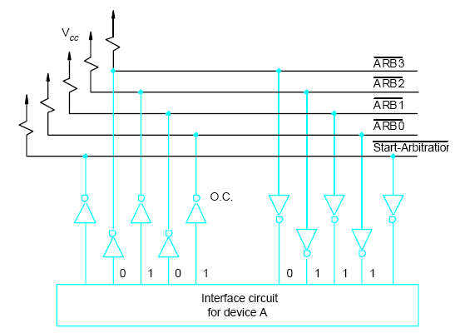

Slide 13
Arbitration process:
  Each device compares the pattern that appears on the arbitration lines to its own ID, starting with MSB.
  If it detects a difference, it transmits 0s on the arbitration lines for that and all lower bit positions.
  The pattern that appears on the arbitration lines is the logical-OR of all the 4-bit device IDs placed on the arbitration lines.

Slide 14
Device A has the ID 5 and wants to request the bus:
- Transmits the pattern 0101 on the arbitration lines.
Device B has the ID 6 and wants to request the bus:
- Transmits the pattern 0110 on the arbitration lines.
Pattern that appears on the arbitration lines is the logical OR of the patterns:
- Pattern 0111 appears on the arbitration lines.
Arbitration process:
Device A compares its ID 5 with a pattern 0101 to pattern 0111.
It detects a difference at bit position ARB1, as a result, it transmits a pattern 0100 on the arbitration lines.
The pattern that appears on the arbitration lines is the logical-OR of 0100 and 0110, which is 0110.
This pattern is the same as the device ID of B, and hence B has won the arbitration.

